Slide 1
Video Game Ratings
OSEMN Pipeline
By David Bauer (778541), David Paquette (789331), Filippo Navarra (782571)

Slide 2
Table of contents
01
Project Goal
03
Visualization
02
04
Findings
Task Analysis
Overview of key steps
Graphs and matrices
Discussion of main results
Dataset description and problem dissection

Slide 3
01
Project Goal
Overview of key steps

Slide 4
OSEMN Pipeline
Obtain the Data
Scrub/Clean the Dataset
FOCUS
Exploratory Data Analysis
Model the Data
EXTRA
INterpret the Results
Notes:
Obtain
Importing the data into a csv
Scrub
Cleaning null values and duplicates
Transform columns
Add information
EDA
Correlation Matrix and Pairwise distribution
Data & Subset variable graphs
Model
Standard scale numeric variables
Make dummies
Split the data
Train Multiple Linear Regression
Interpet
Evaluate the model (Rsquared & Residual plots)

Slide 5
02
Task Analysis
Dataset description and problem dissection

Slide 6
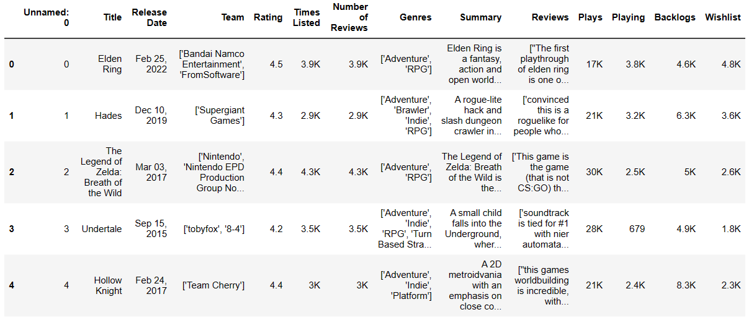
Data Set
Notes:
Problems:
1512 rows and 14 columns
Very little nulls or duplicates
Double Index
Release date too complicated
Teams has too many individual variables (657 unique Teams)
Times listed and Number of Reviews is identical (also perfect correlation)
Genres is a list of Genres for each Rows
Summary and Reviews are full text
Numbers as Strings of 3.9K

Slide 7
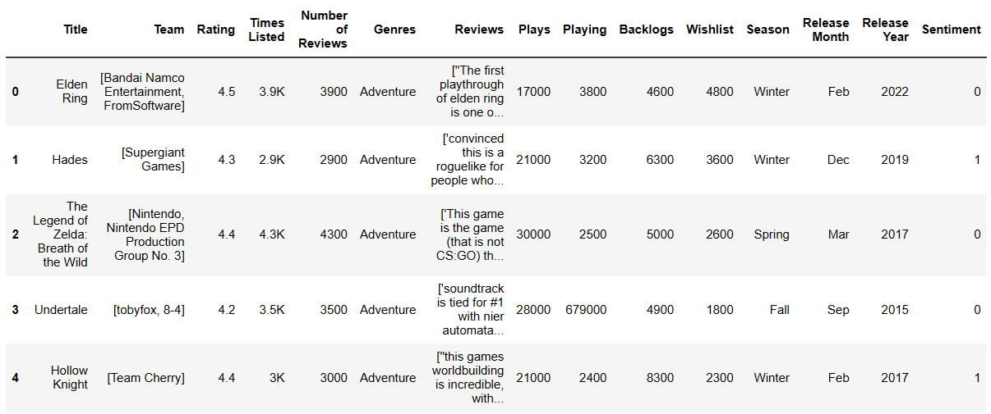
Clean Data Set
Notes:
Drop nulls, duplicates and double index
Clean Team Name strings
Reviews, Summary, Teams and Times Listed will be dropped for final model building
Genres reduced to the main genre
Clean string representations of 3.9K into 3900 (except for Times Listed cause it has perfect correlation with Number of Reviews and therefore identical)
Release date split into Month, Year and Season
Tried a KNN clustering sentiment analysis with bag of words of good and bad sentiment (just and attempt out of curiosity)
Reduced to 1083 and increased to 15 columns

Slide 8
03
Visualization
Graphs and matrices

Slide 9
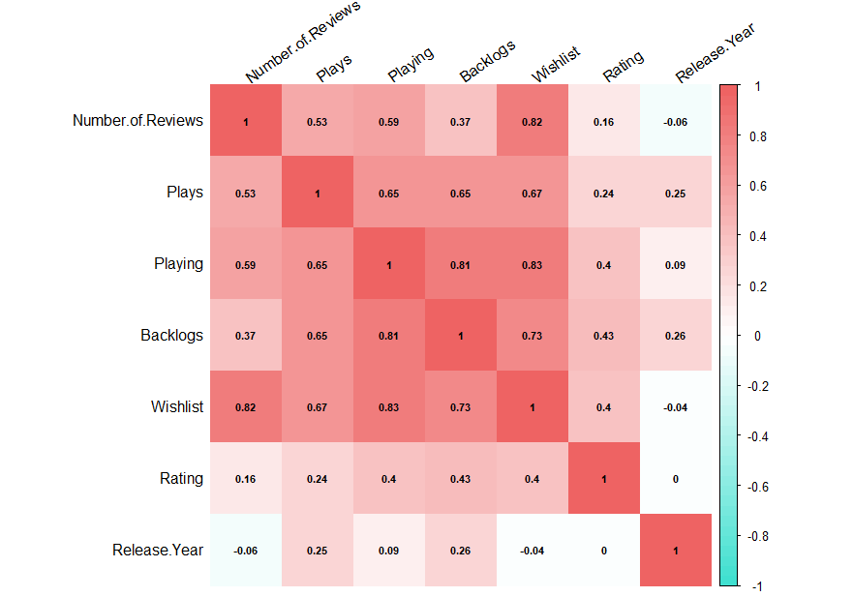
Pearson Correlation Heat Map

Slide 10
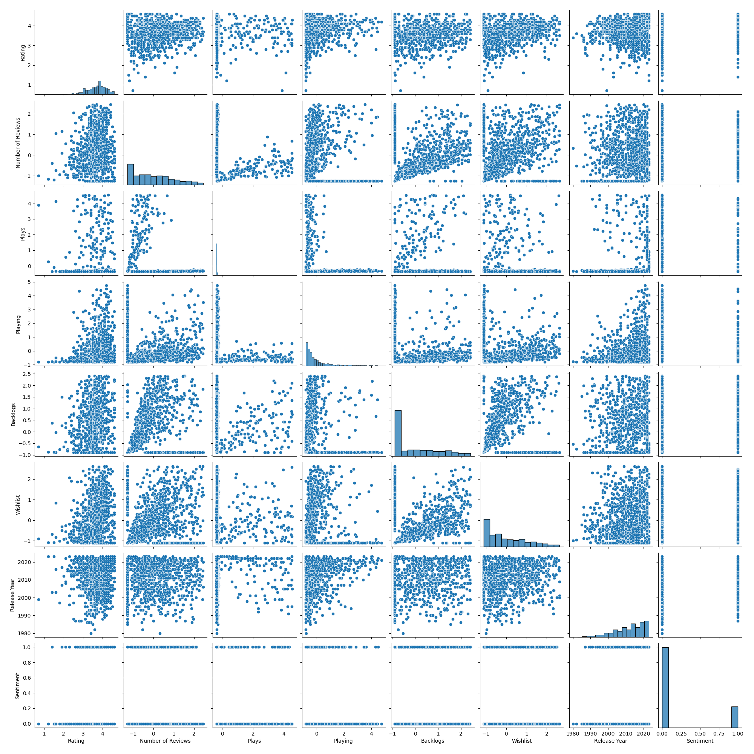

Slide 11
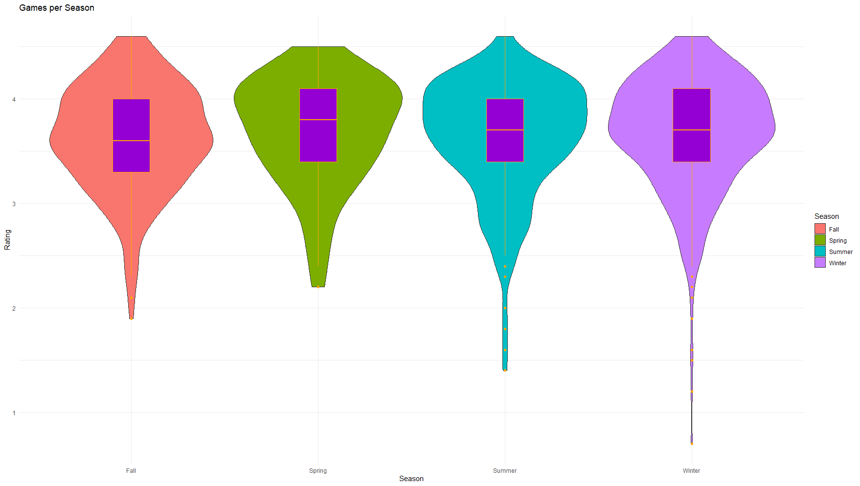
Ratings per Season

Slide 12
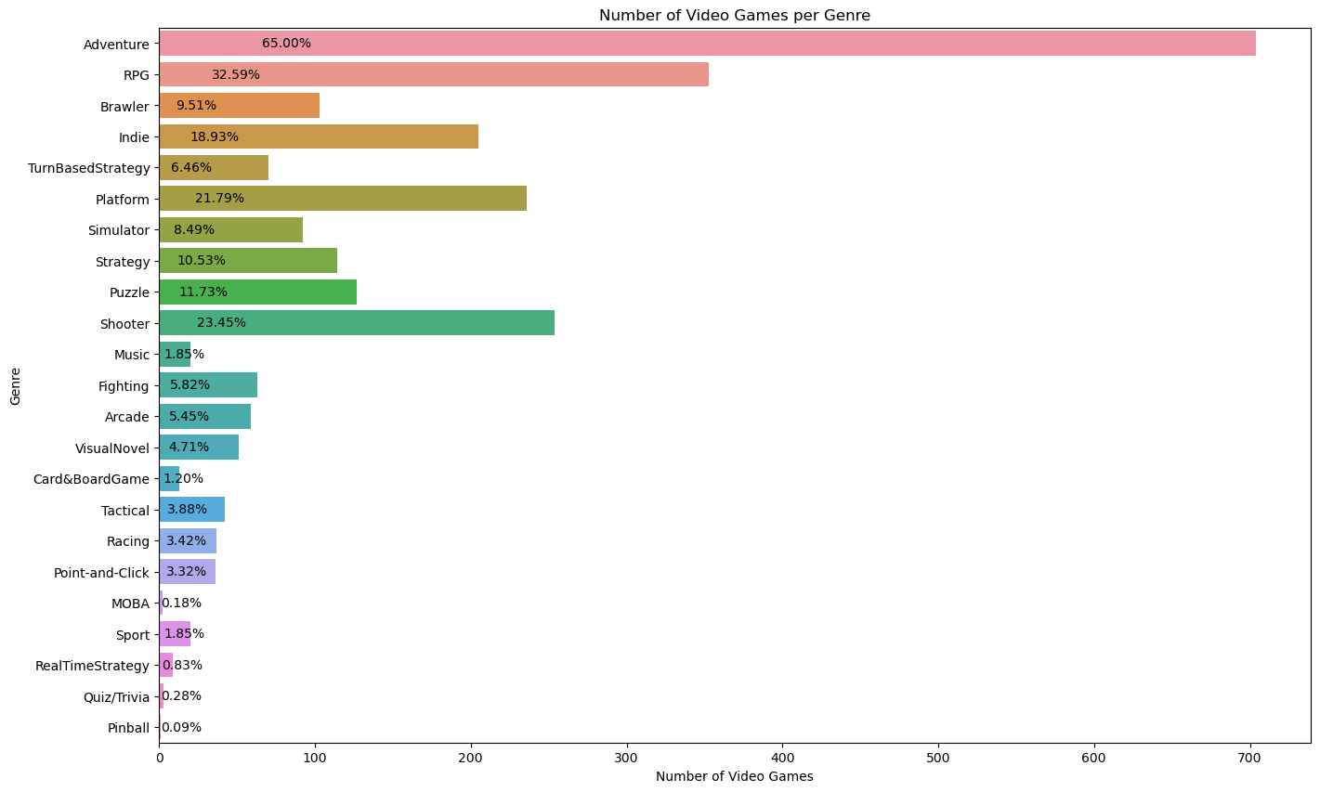
Games per Genre

Slide 13
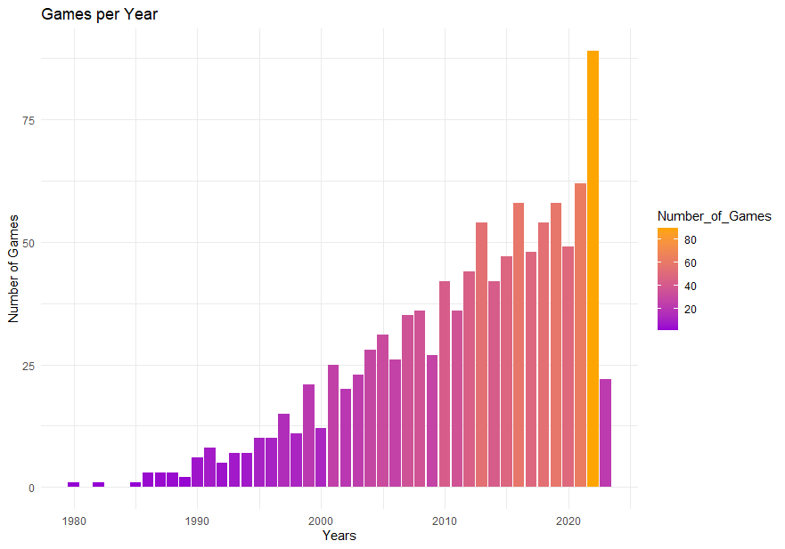
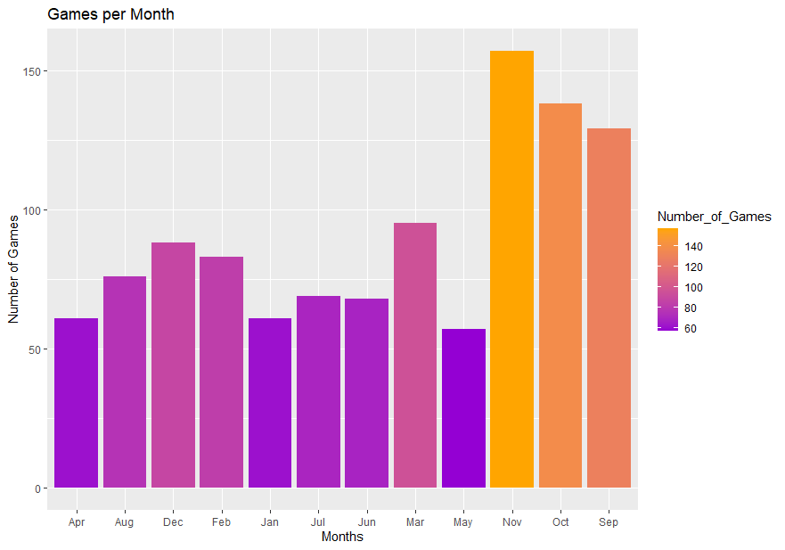
Games over Time

Slide 14
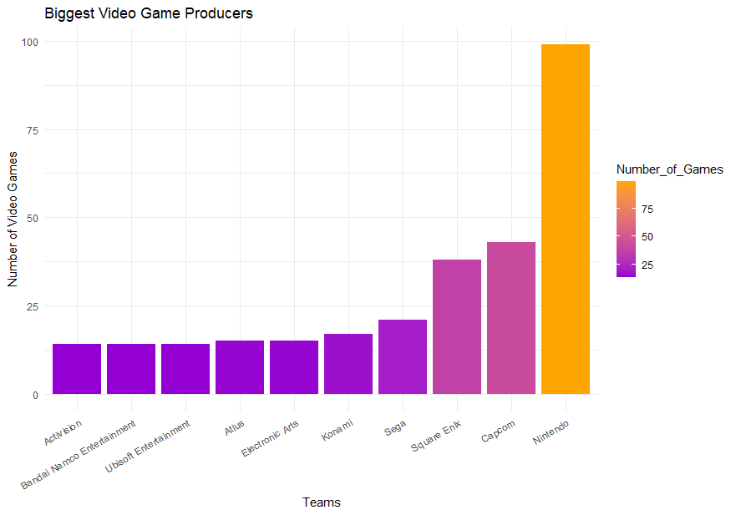
Top 10 Producer Teams

Slide 15
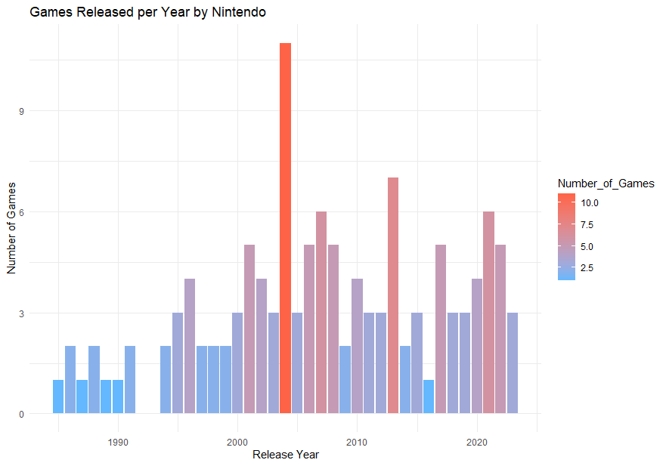
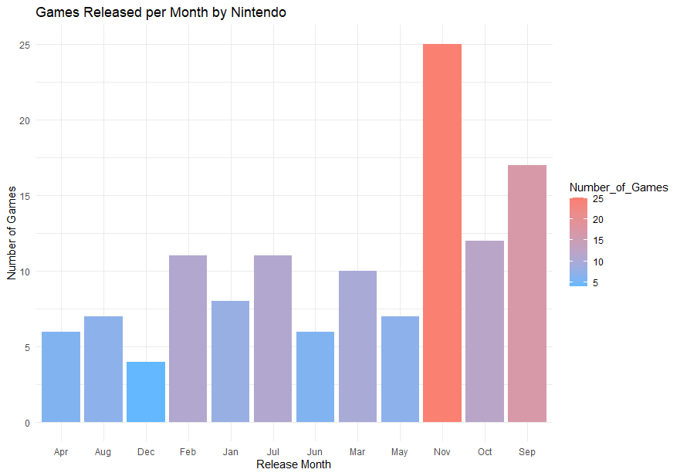
Nintendo Games over Time

Slide 16
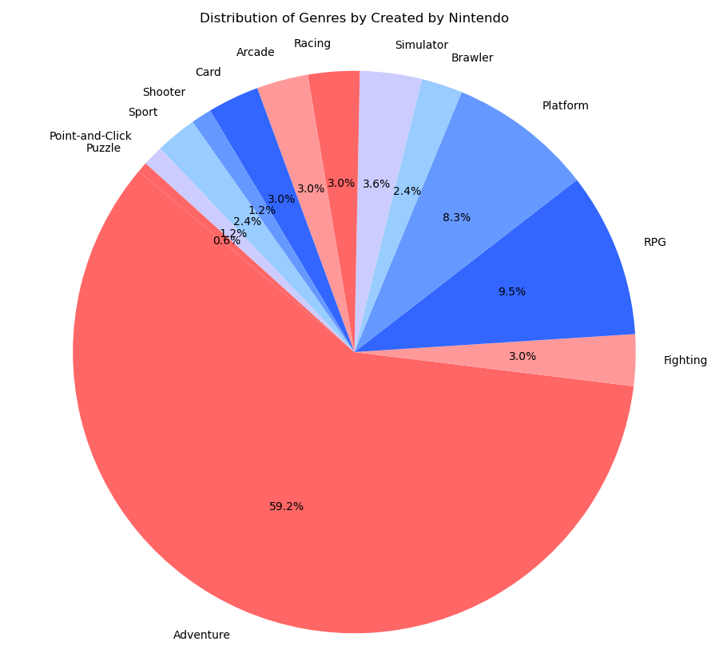
Nintendo Genres

Slide 17
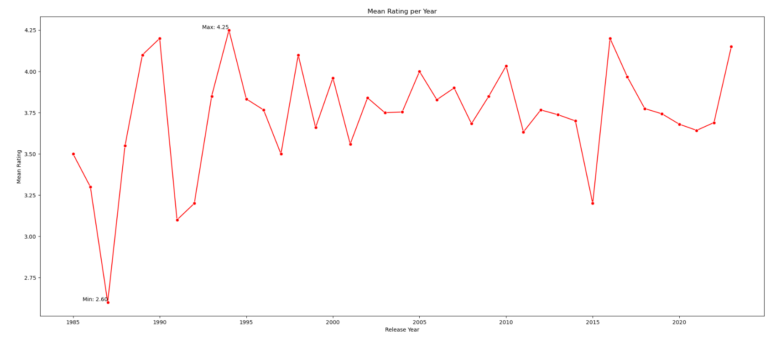
Nintendo Games Mean Rating over the Years

Slide 18
04
Findings
Discussion of main results

Slide 19
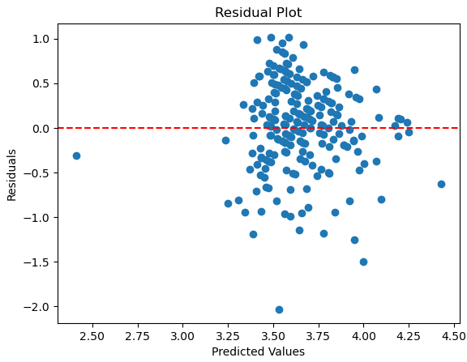
Multiple Linear Regression Evaluation
Residuals:
Min 1Q Median 3Q Max
-2.14936 -0.20647 0.02294 0.24442 1.24593
Coefficients: (7 not defined because of singularities)
Estimate Std. Error t value Pr(>|t|)
(Intercept) 3.25636 0.43133 7.550 1.32e-13 ***
Number.of.Reviews -1.53705 0.20267 -7.584 1.03e-13 ***
Plays -0.45280 0.24098 -1.879 0.0607 .
Playing 0.30736 0.22026 1.395 0.1633
Backlogs 0.29017 0.23504 1.235 0.2174
Wishlist 2.53207 0.33512 7.556 1.26e-13 ***
Release.Year -0.19108 0.10198 -1.874 0.0614 .
GenresAdventure 0.46886 0.42558 1.102 0.2710
GenresArcade 0.47722 0.43377 1.100 0.2716
GenresBrawler 0.44139 0.44096 1.001 0.3172
…
Release.MonthJan -0.18972 0.07854 -2.416 0.0160 *
Release.MonthJul -0.04550 0.07907 -0.575 0.5651
Release.MonthJun -0.07524 0.07470 -1.007 0.3142
…
Signif. codes: 0 ‘***’ 0.001 ‘**’ 0.01 ‘*’ 0.05 ‘.’ 0.1 ‘ ’ 1
Residual standard error: 0.4206 on 722 degrees of freedom
Multiple R-squared: 0.3222,Adjusted R-squared: 0.2903
F-statistic: 10.09 on 34 and 722 DF, p-value: < 2.2e-16

Slide 20
Conclusion
Cleaned, transformed, added and dropped columns
Plotted (LOW) Correlation and Pairwise Distributions
Created various exploratory graphs for data & variable subsets
Tested a Multiple Linear Regression Modeling
Statistically and graphically evaluated the (bad) performance

Slide 21
Thank you for you Attention!

